Slide 1
Java Review Object Oriented Programing
SDEV 301

Slide 2
Topics
Class design
Inheritance
Abstract classes & polymorphism
Interfaces
Static vs. non-static data

Slide 3
Class design
Java Review

Slide 4
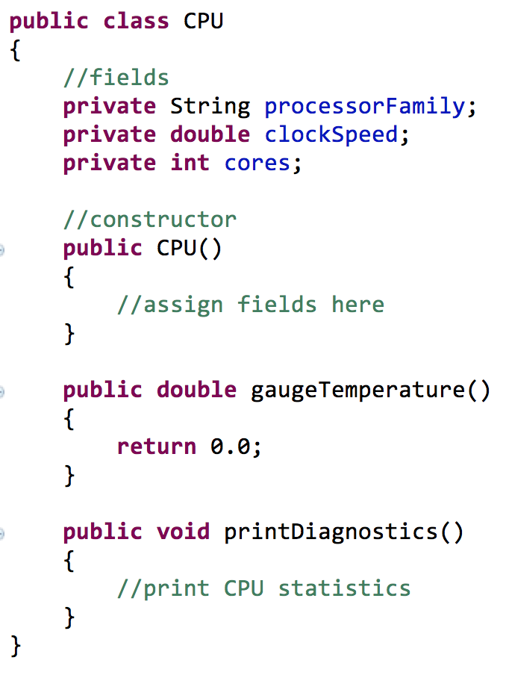
Class design
Classes are blueprints for creating objects
Classes consist of
Fields
Constructors
Methods

Slide 5
Access modifiers
Determines the visibility of field
Modifier | Example | Class | Package | Subclass | World
private | private double radius; | Y | N | N | N
public | public static final int MAX = 10; | Y | Y | Y | Y
protected | protected String name; | Y | Y | Y | N
package | int number; | Y | Y | N | N

Slide 6
Three Pillars of OOP
OOP
Encapsulation
Intentionally hiding
data – abstraction!
Dynamic behavior!
Polymorphism
Inheritance
Code reuse!

Slide 7
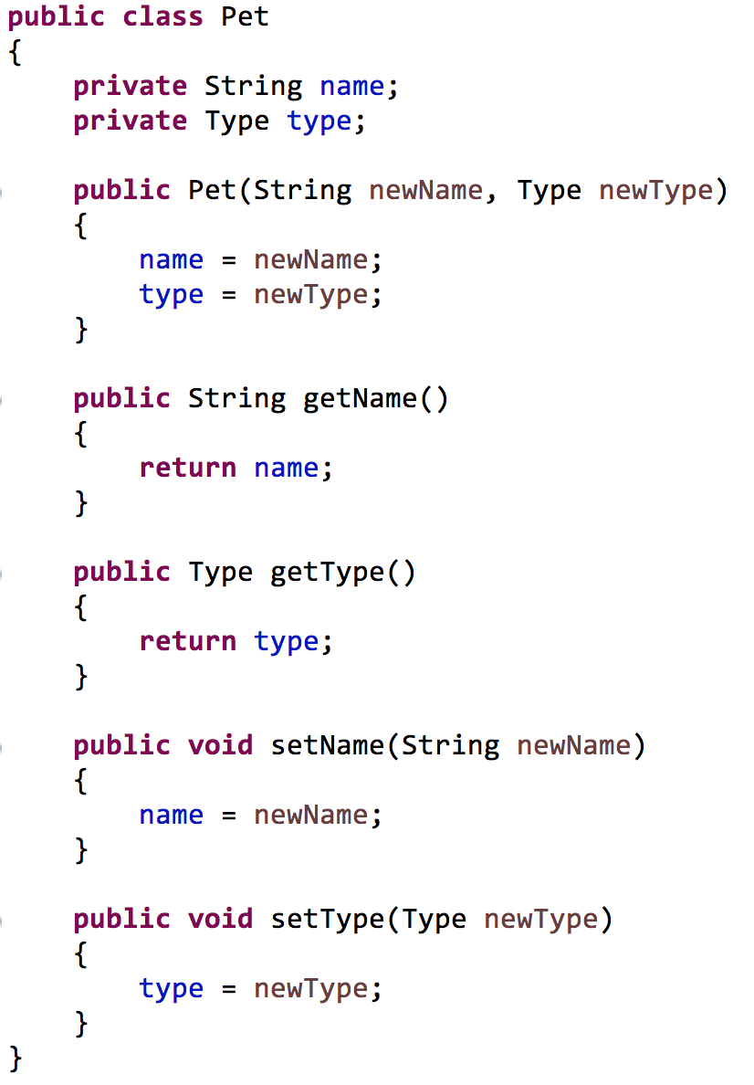

Encapsulation
Hiding the internal details of a class
Private fields
Public accessors, mutators

Slide 8
Encapsulation
When using a class we’re primarily concerned with the public interface
Car Object
getAverageMPG()
isMadeInUsa()
calculateResellValue()
make
model
engineType
milesDriven
Private details
Public interface
(visible)

Slide 9
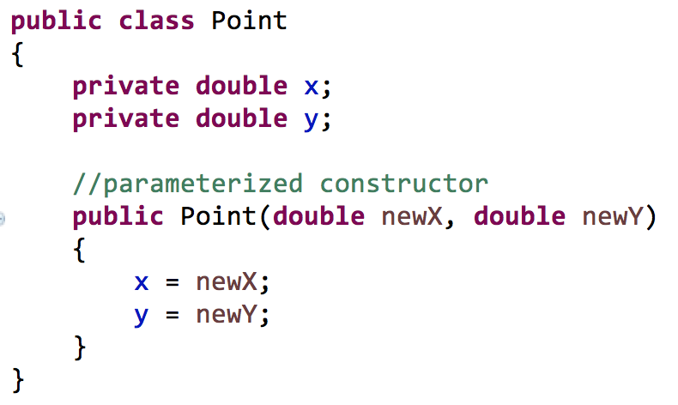
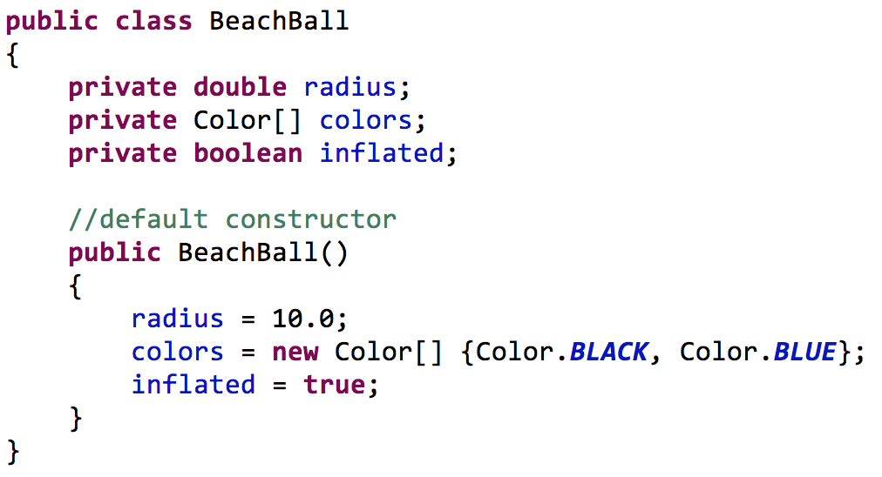
Constructors
Used during instantiation

Slide 10
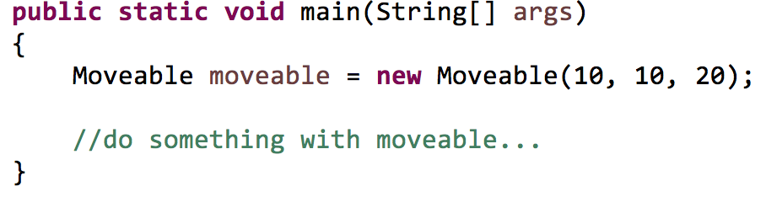
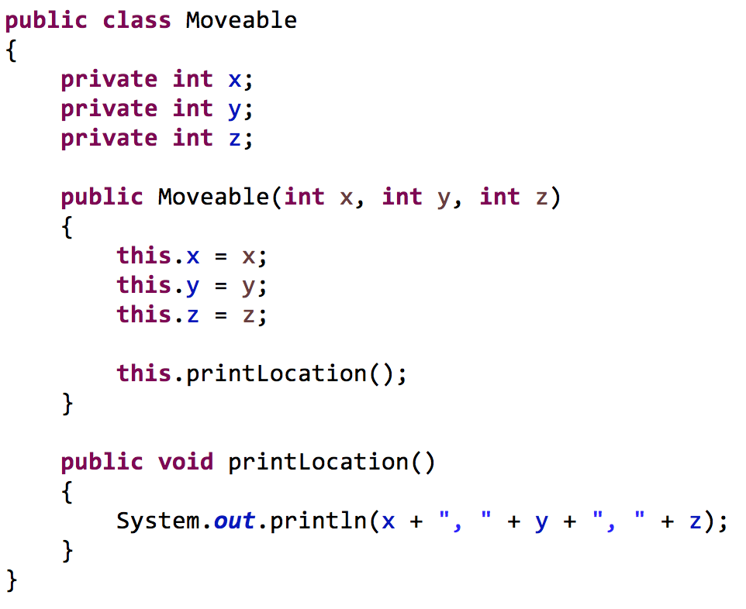
“this” keyword
create
x = 10
y = 20
z = 5
Refer to field
Refer to method

Slide 11
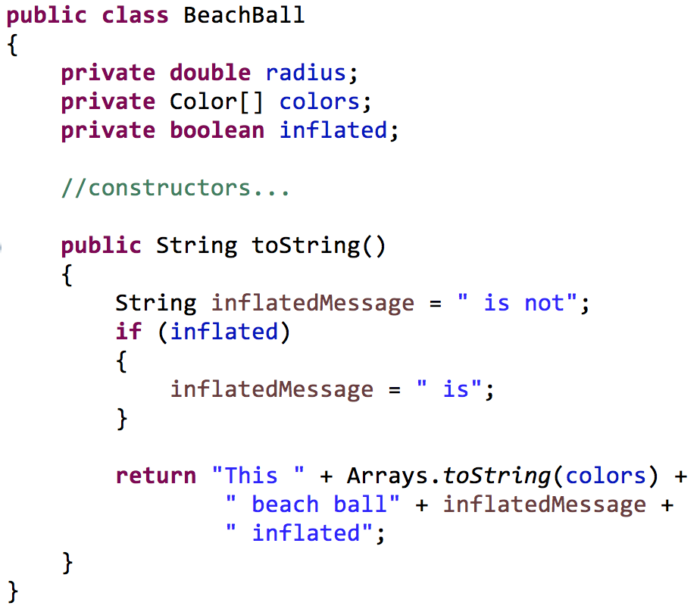
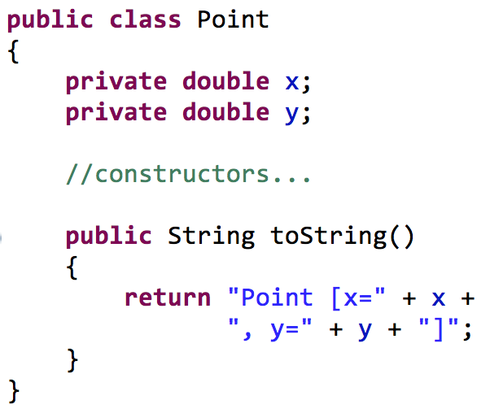
The toString() method
Returns a string representation of an object

Slide 12
Inheritance
Java Review

Slide 13
Inheritance
Definition: a class borrowing “functionality” from another class
Goal: to reduce redundant (repeated) code
Hourly Employee
First, last name
Address
Birthdate
Position
Hourly wage
Hours worked
Salary Employee
First, last name
Address
Birthdate
Position
Salary
Benefits
shared data

Slide 14
Inheritance
Move shared data to a common class
Then “borrow” that data
Employee
First, last name
Address
Birthdate
Position
Hourly Employee
Hourly wage
Hours worked
Salary Employee
Salary
Benefits

Slide 15
Inheritance
This new relationship is called inheritance
We say a “child” class “inherits” from a “parent” class
Other terminology
Parent Class
Base class
Super class (Java)
Child Class
Derived class
Sub class (Java)

Slide 16
Inherited functionality
Classes
Objects
Employee
First, last name
Address
Birthdate
Position
Fields | Methods
Name Address Birthdate Position | getName() getAddress() toString()
Parent
Note: Fields are
only inherited
if public
Hourly Employee
Hourly wage
Hours worked
Fields | Methods
Hourly wage Hours worked Name Address Birthdate Position | getHourlyWage() getHoursWorked() getName() getAddress() toString()
Child

Slide 17
Levels of abstraction
Each class can have a parent class, including your parent
These relationships are called IS-A relationships
eg. An hourly employee is an employee. An employee is a tax payer.
Relationships should mirror their real-world counterparts
Tax Payer
Employee
Hourly Employee

Slide 18
Class hierarchies
Hierarchies of relationships can be defined
Tax Payer
Employee
Hourly Employee
Intern
Salary Employee
Part Time Employee
Full Time Employee
Engineer Employee
Manager Employee

Slide 19
Terminology
Tax Payer
parent
Employee
child
Hourly Employee
Intern
Salary Employee
Part Time Employee
Full Time Employee
Engineer Employee
Manager Employee

Slide 20
Terminology
Tax Payer
Employee
ancestors of
SalaryEmployee
Hourly Employee
Intern
Salary Employee
Part Time Employee
Full Time Employee
Engineer Employee
Manager Employee

Slide 21
Terminology
Tax Payer
Employee
descendants of
Employee
Hourly Employee
Intern
Salary Employee
Part Time Employee
Full Time Employee
Engineer Employee
Manager Employee

Slide 22
Inheritance
A class inherits public methods and fields from all ancestors
”Functionality travels down-hill”
Tax Payer
getSSN()
calculateTaxes()
Employee
getSSN()
calculateTaxes()
getFullName()
getPosition()
functionality
Hourly Employee
getSSN()
calculateTaxes()
getFullName()
getPosition()
calculatePaytotal()
getHours()

Slide 23
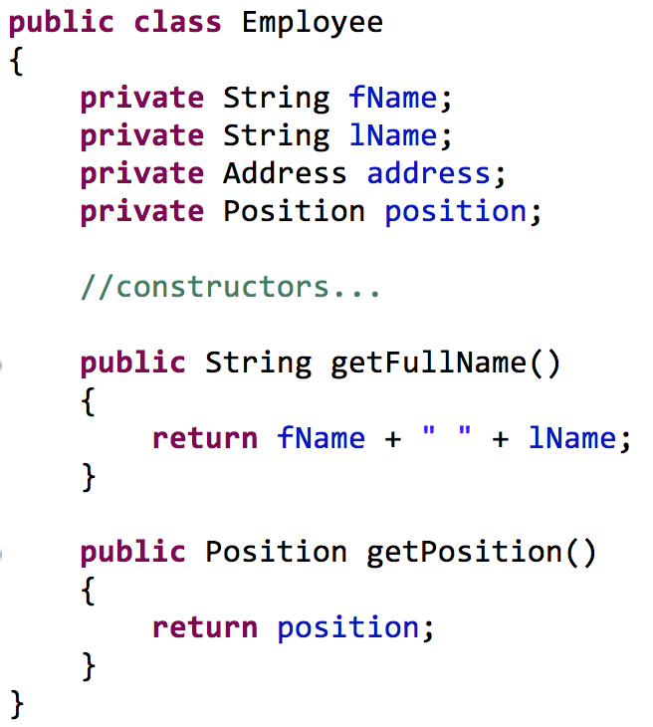
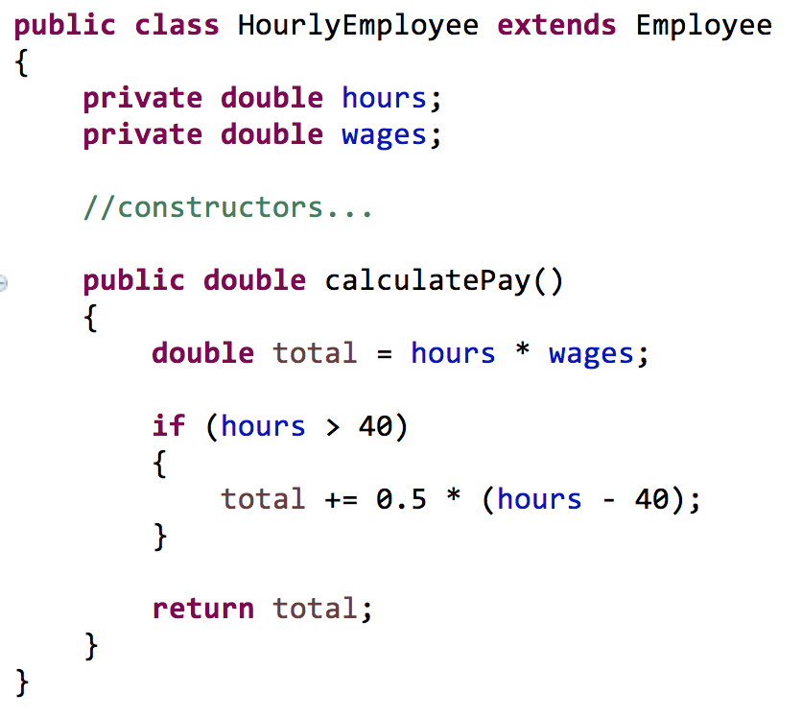
Example
Extends keyword declares a
parent/child relationship

Slide 24
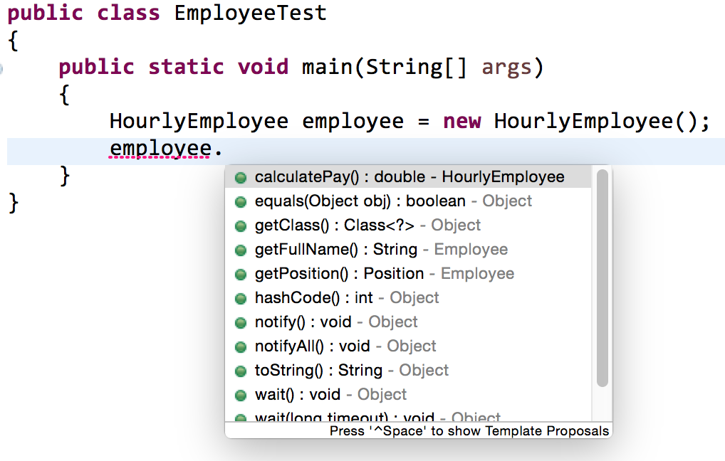
Example
Methods from
HourlyEmployee
Methods from Employee
Methods from Object

Slide 25
Object class
Rule: If a class does not inherit from another class, then it automatically inherits from the Object class
Object
Abbreviated list of Object methods
toString(): returns a string representation of an object
equals(): compares two objects for equality
hashcode(): generates a number used for “quick” equality checks
getClass(): returns an object that can describe a class
Tax Payer
Employee
Hourly Employee

Slide 26
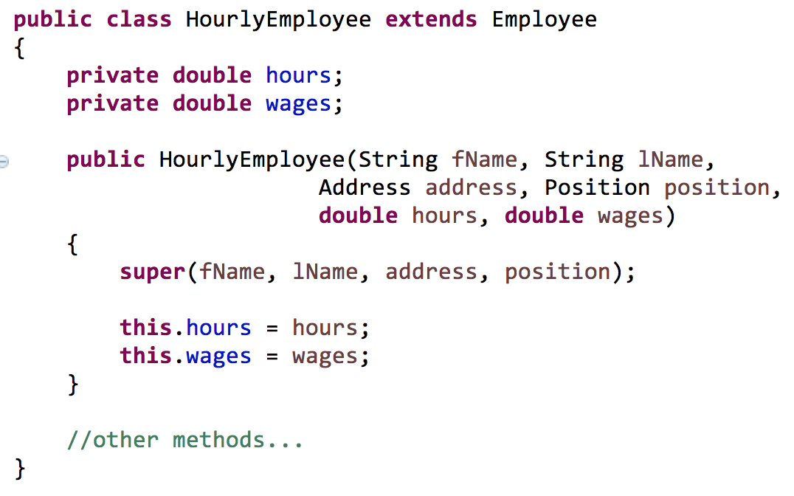
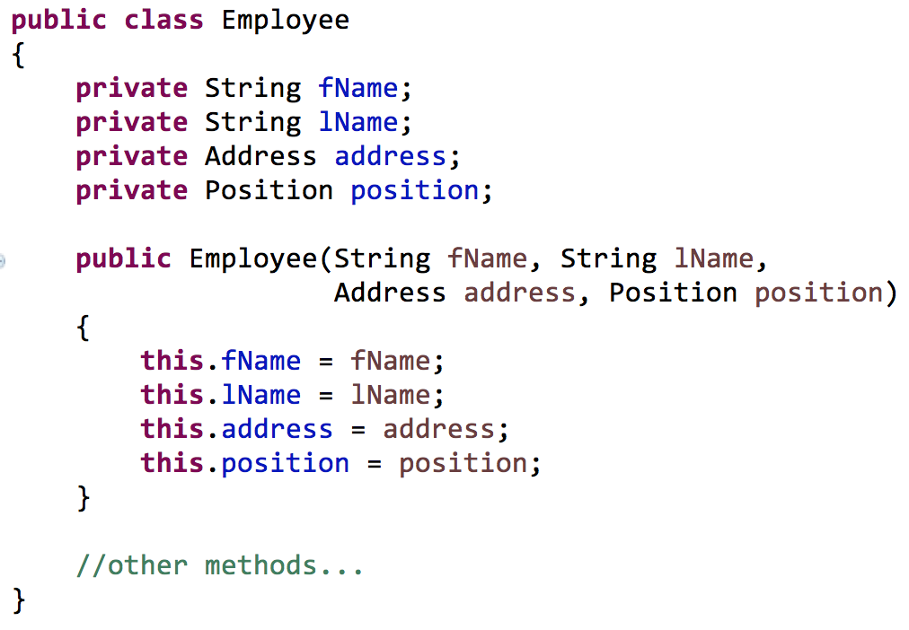
Super constructors
A child class can call the constructor of a parent class

Slide 27
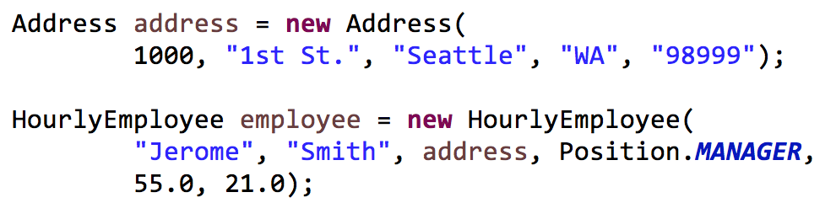
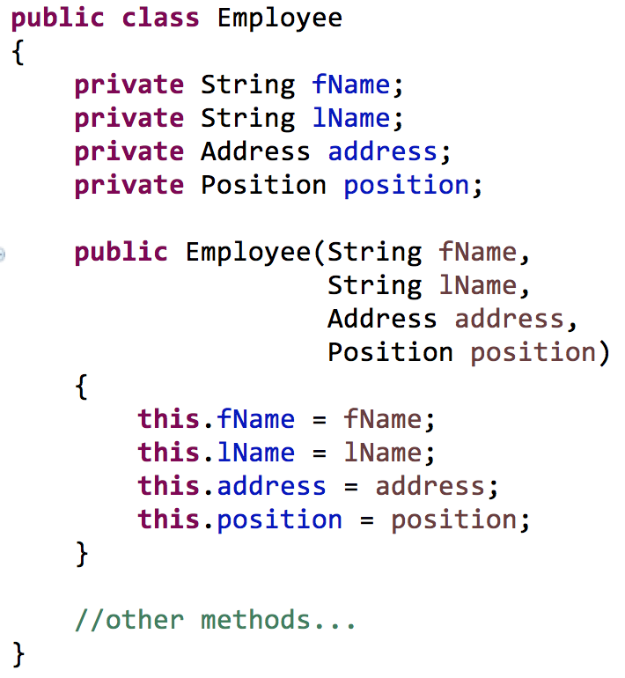
Passing data to a parent class

Slide 28
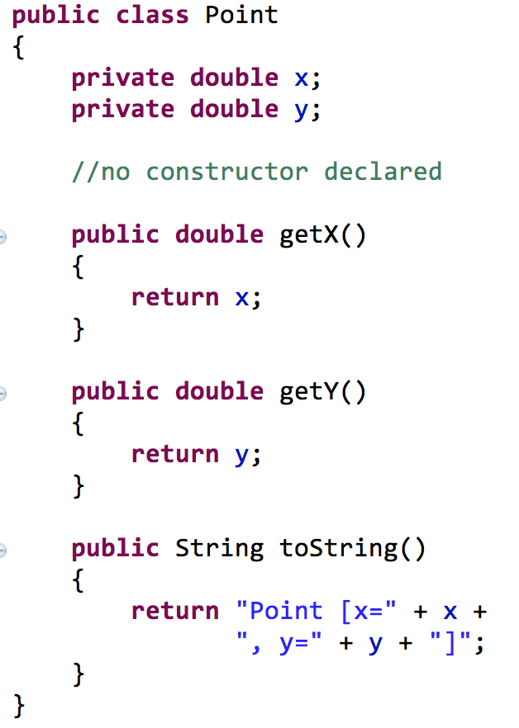
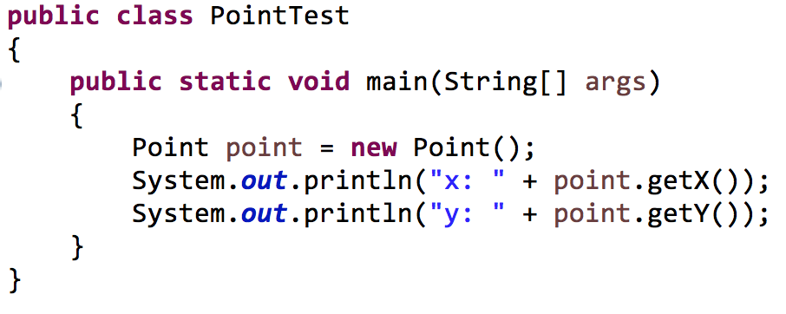
Implicit constructors and calls
Rule: if no constructor is defined in a class, a default constructor is added implicitly
call made to implicit
default constructor

Slide 29
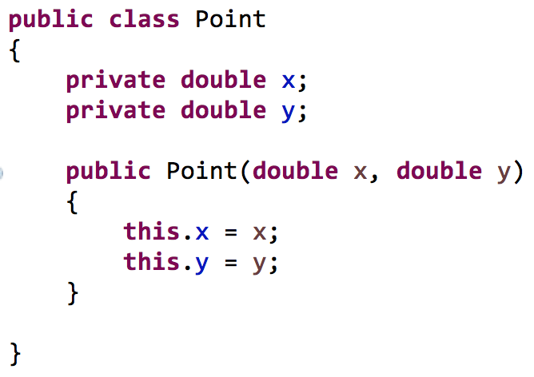
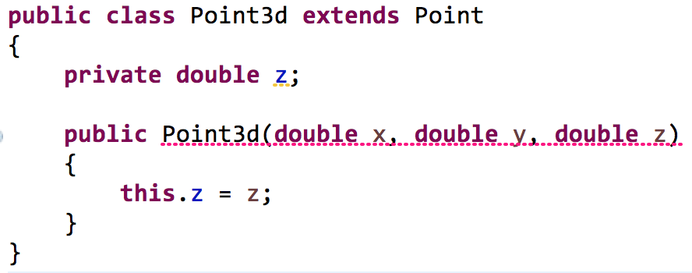
Implicit constructors and calls
Rule: if no call is made to a super constructor, a call to super() is made implicitly
super();
is added here

Slide 30

Overloading and overriding
Overloading: two or more methods with the same name but “different” parameters
Overriding: redefining a method that a class inherited (same method signature)

Slide 31
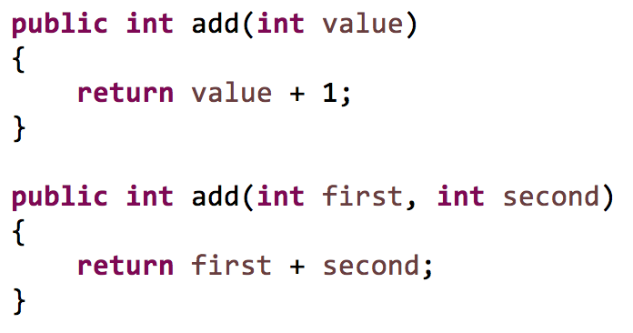
Overloading
Defining two or more methods with the same name but “different” parameters
Number of arguments differ

Slide 32
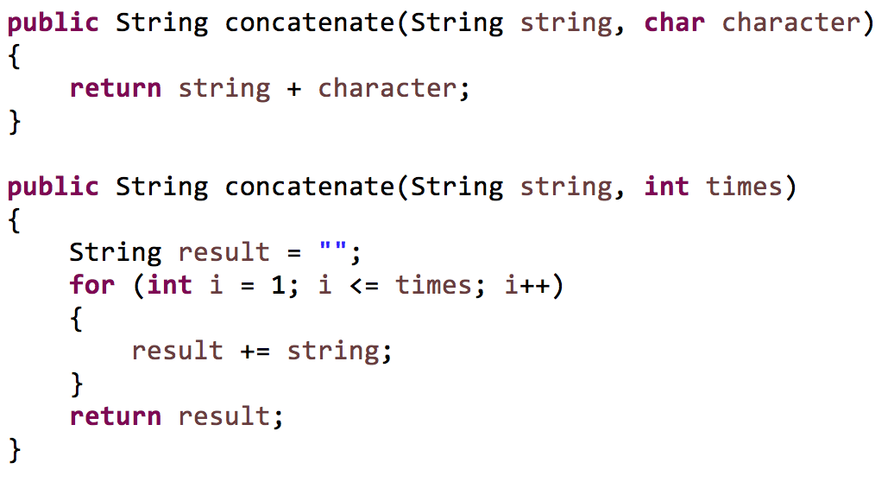
Overloading
Types of arguments differ

Slide 33
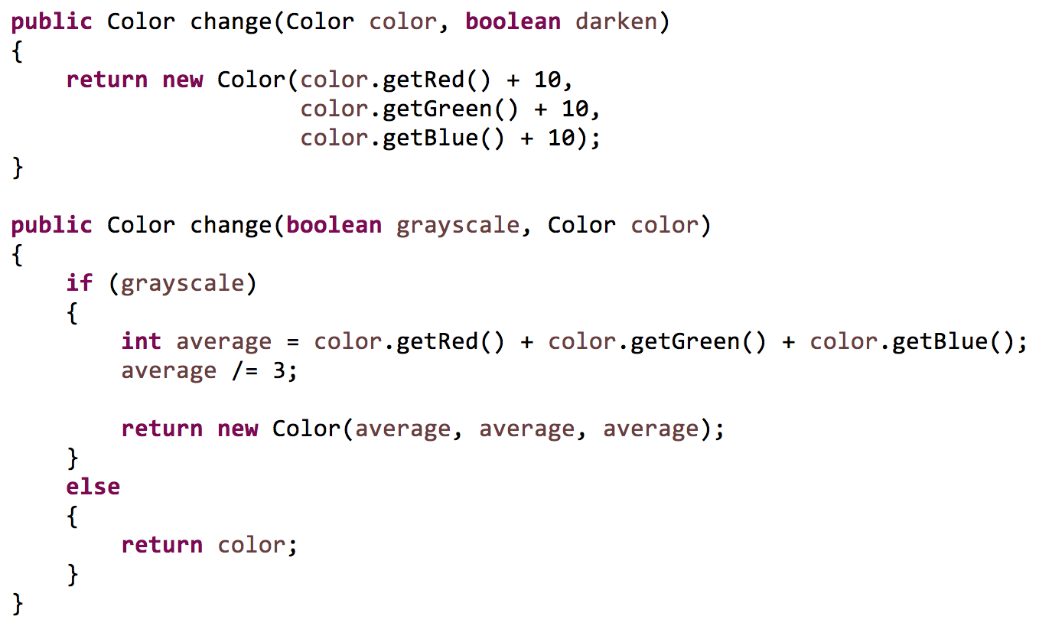
Overloading
Order of arguments differ

Slide 34
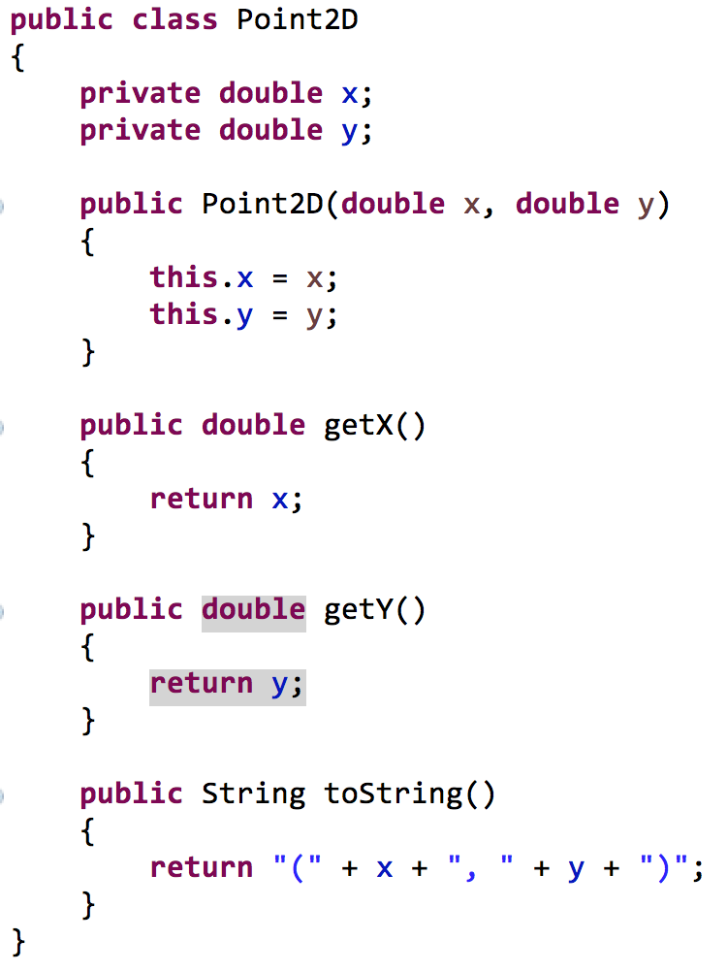
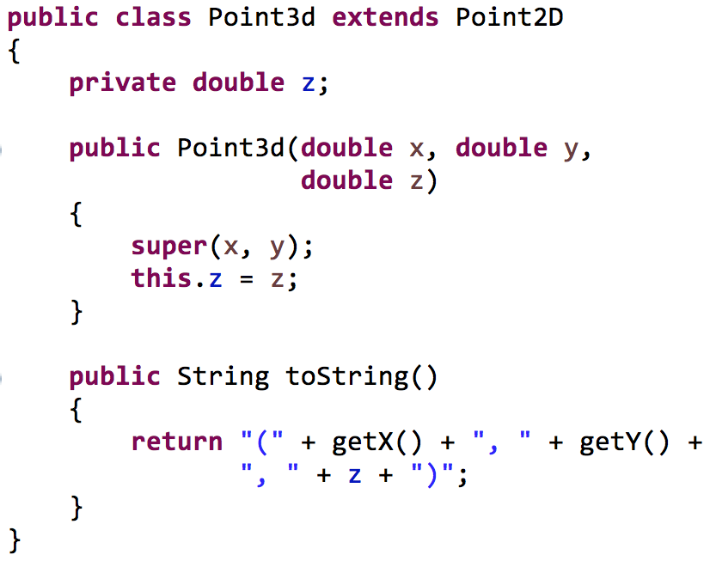
Overriding
Redefining a method that a class inherited

Slide 35
Overloading and overriding
When a method is invoked, it will execute the method that was last overriden
Object
toString()
Point3D newPoint = new Point3D(10, 20, 30);
newPoint.toString();
Point
toString()
Point newPoint = new Point (25, 35);
newPoint.toString();
Point3D
toString()

Slide 36
Abstract classes & polymorphism
Java Review

Slide 37
Abstract classes
Sometimes it does not make sense to instantiate a class
//is this useful?
Shape myShape = new Shape(“Circle”);
Shape
shapeName
Rectangle
width, height
Oval
radiusX, radiusY
RightTriangle
base, height
Square
Circle

Slide 38
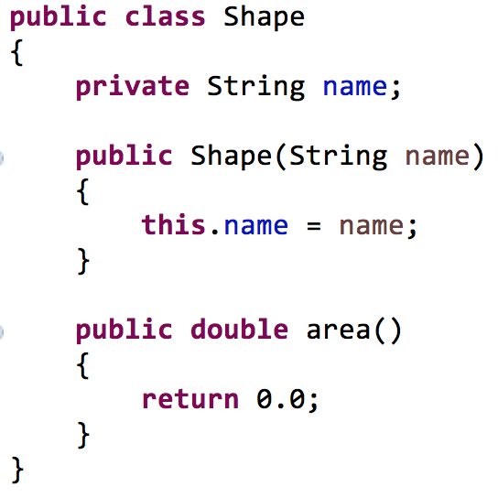
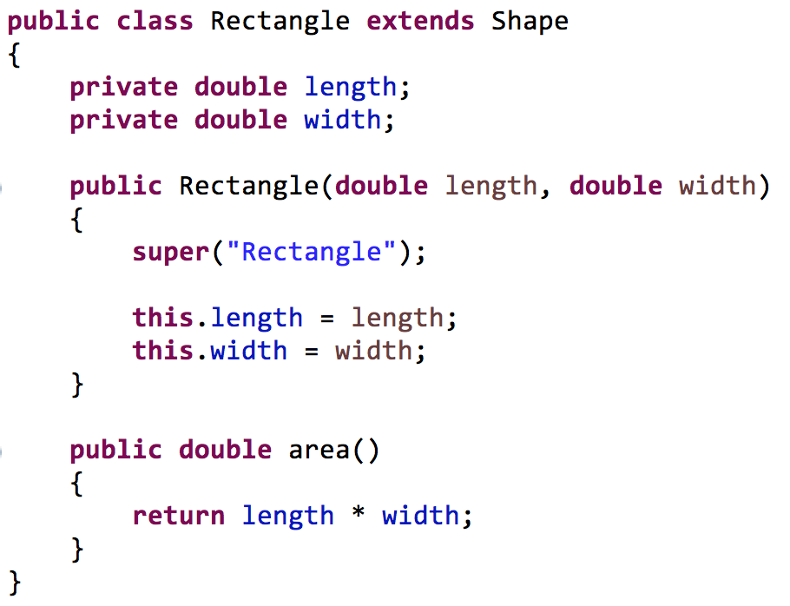
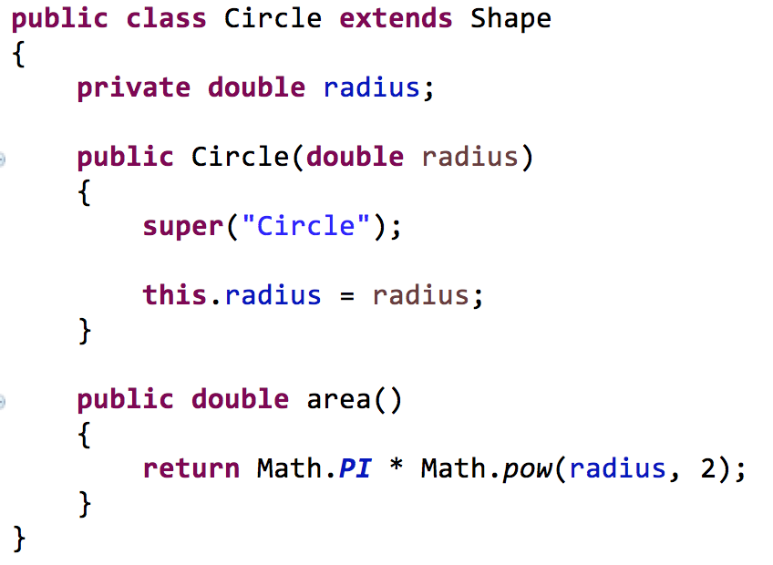
Abstract classes
Sometimes we define a method only to override it

Slide 39
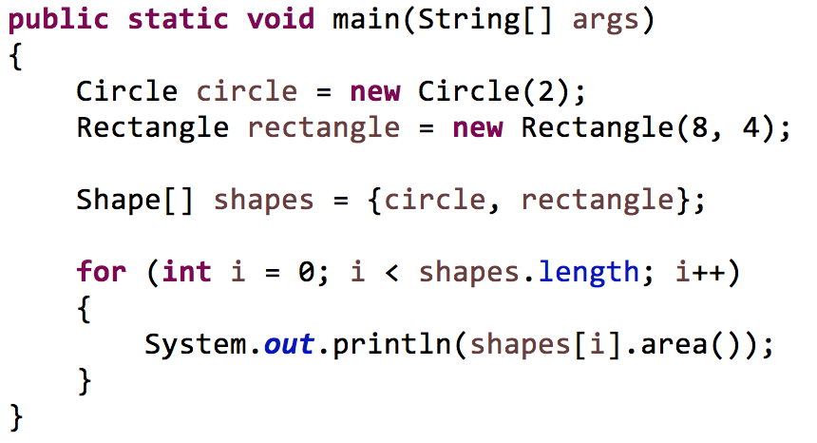
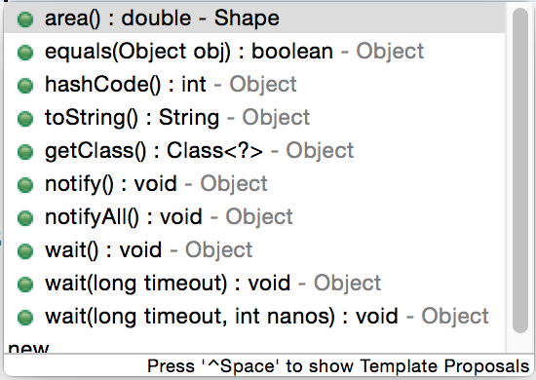
Abstract classes
We can use up-casting to group our shapes
Only methods from the variable type (Shape) can be called from the variable
Methods available to Shape variables

Slide 40
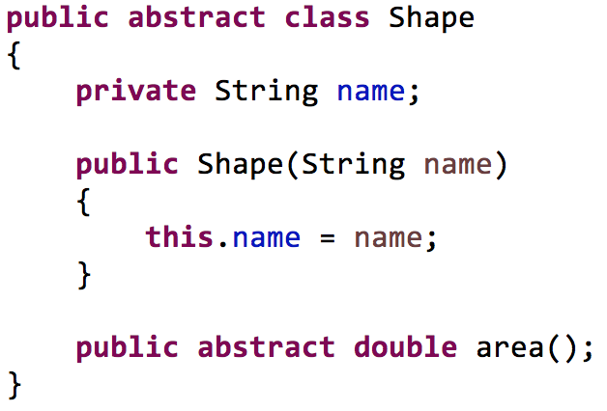
Abstract classes
Allows us to define a parent class that
cannot be instantiated
has methods whose only purpose is to be overridden (abstract methods)
abstract keyword
no method body

Slide 41
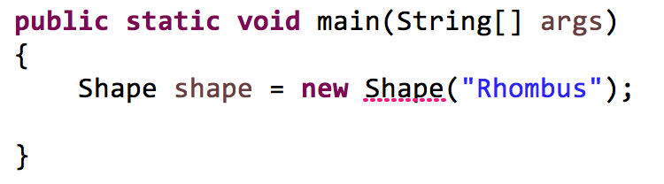
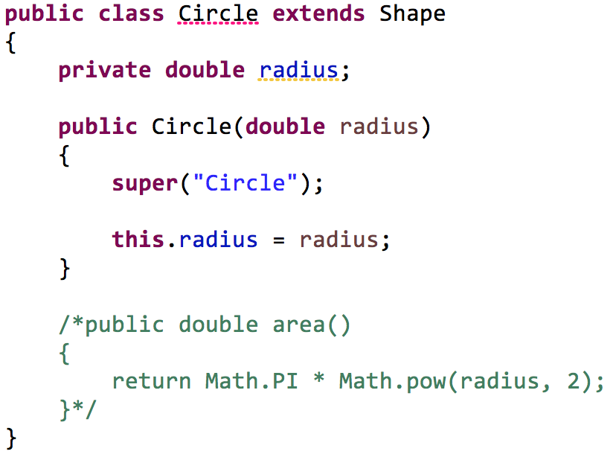
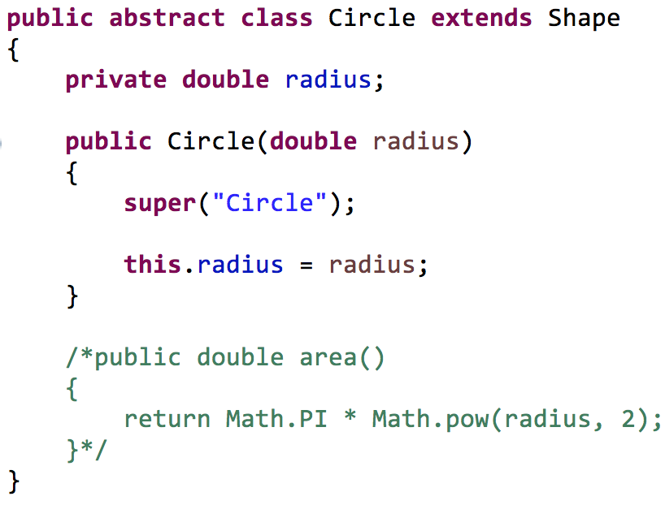
Abstract class
Rule: you cannot instantiate an abstract class
Rule: a child class must implement all abstract methods of an parent class OR must also be abstract

Slide 42
Interfaces
Java Review

Slide 43
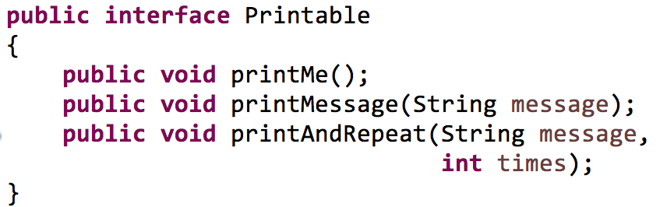
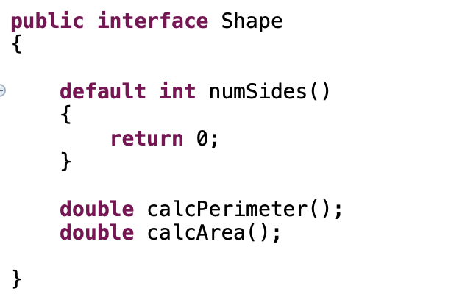
Interfaces
Java interfaces often contain abstract methods
Methods without implementations
An interface is declared in its own file
Java interfaces can contain default methods which contain methods with code

Slide 44
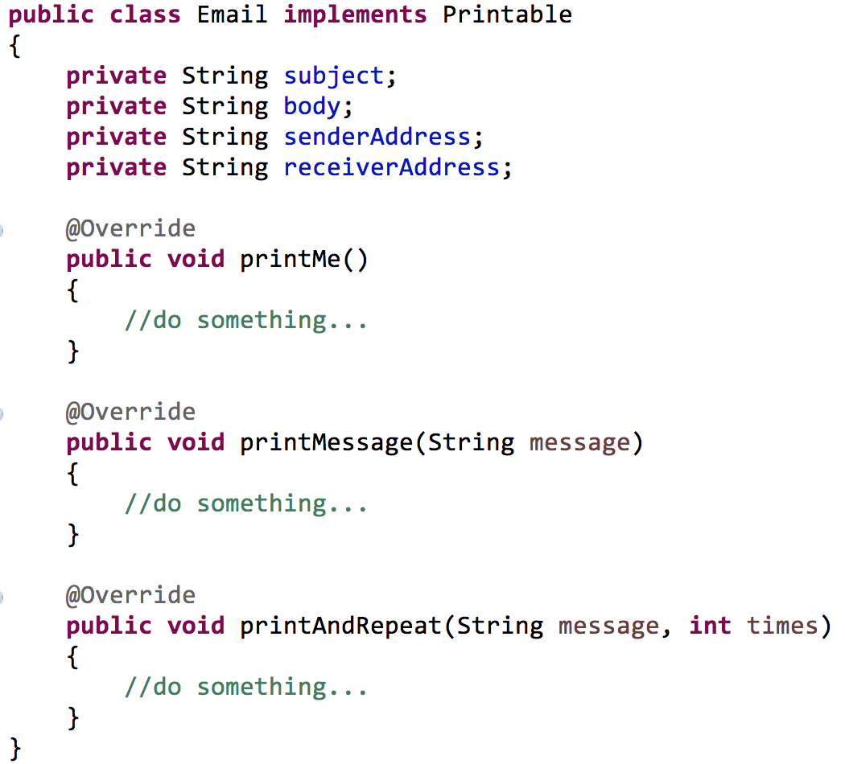
Interfaces
We say that a class implements an interface
“implements” rather
than “extends”

Slide 45
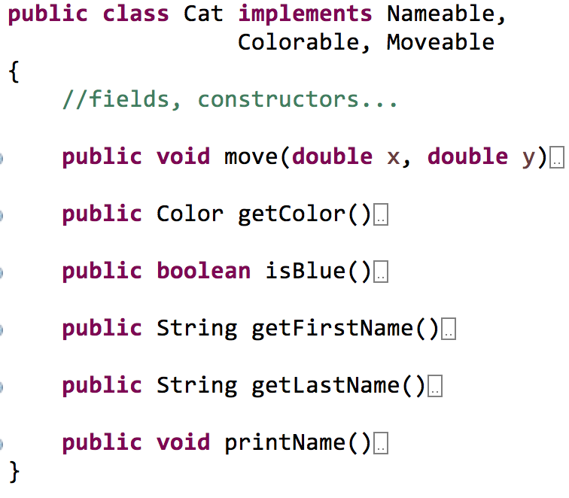
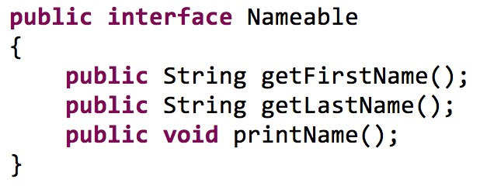
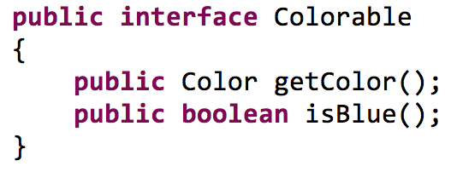
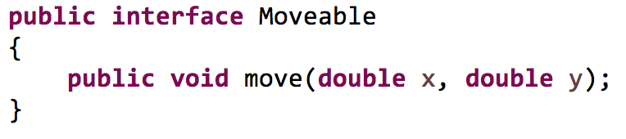
Interfaces
Java does not support multiple inheritance
Java approximates multiple inheritance by supporting multiple interfaces per class

Slide 46
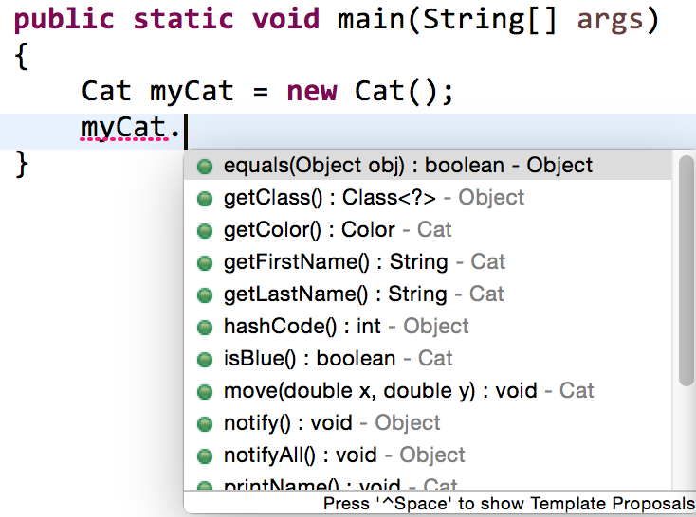

Using multiple interfaces
Colorable
Nameable
Moveable

Slide 47
Static vs. non-static data
Java Review

Slide 48
Static vs. non-static
A field can be declared static
The field is shared among all instances of the class
eg. There is only one data value for that field
Point
x, y
static pointCount
class
pointCount = 3
x = 10
y = 20
x = -2
y = 5
x = 44
y = 100
objects

Slide 49
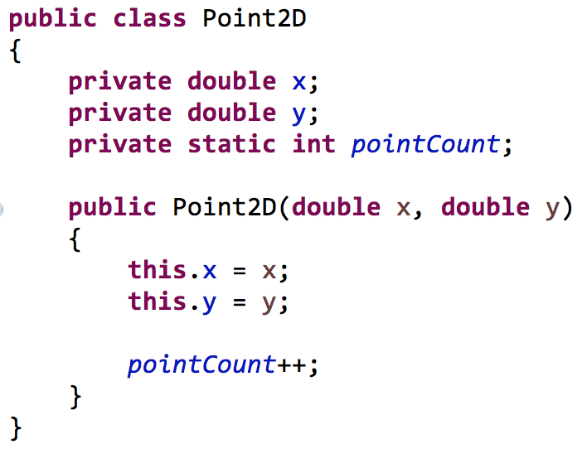
Static vs. non-static
Suppose we create 100 Point2D objects
Each object has an x field, 100 in all
Each object has an y field, 100 in all
There is only one pointCount field, shared by all

Slide 50
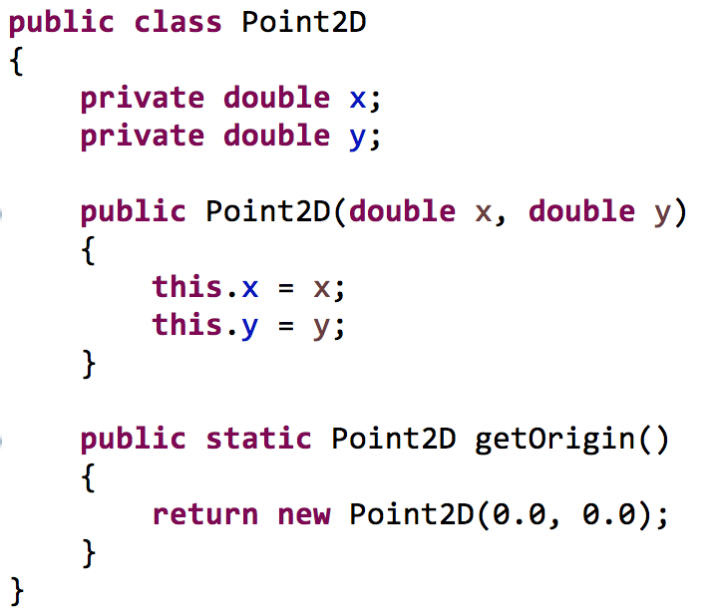
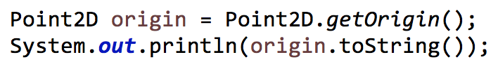
Static vs. non-static
A method can be declared static
No object is required to invoke the method, only the class name

Slide 51
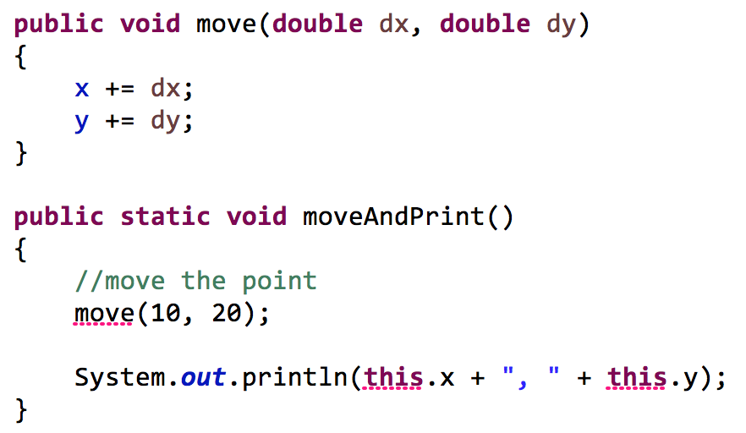
Static vs. non-static
When inside of a static context (method)
Rule: you cannot access non-static fields
Rule: you cannot access non-static methods (which might try to access non-static fields)
cannot access
non-static method
cannot access
non-static field

Slide 52
Static class content
Math class
Fields: Math.PI, Math.E
Methods: Math.pow(), Math.abs(), Math.round() …
String class:
Methods: String.valueOf()
Integer, Double class
Methods: Integer.parseInt(), Double.parseDouble()

Slide 53
Java Review Object Oriented Programing
SDEV 301

